Slide 1
PART 2
Importance of promoting the employment of persons with disabilities

Slide 2
Profile of the disabled population and current employment situation

Slide 3
Comparison of U.S. Views
×
Equality of opportunity
√
Equality of results

Slide 4
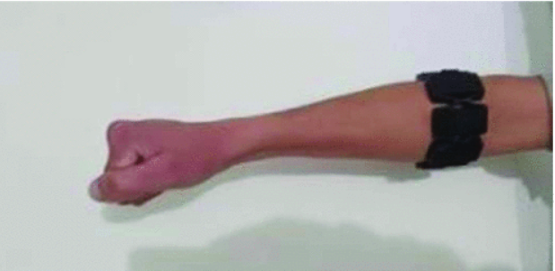
Technical aids for the employment of persons with disabilities——EMG
EMG controls drones to help with agricultural irrigation tasks
Notes:
Myo-armband was placed on the forearm gripping tight enough to examine any type of contraction and relaxation of the muscles. Specific gestures performed by the muscles would cause contraction and relaxation in muscles generating EMG signals. The signals varied for different gestures. The goal was to discriminate these signals with respect to their specific gestures and to use them as command signals for the quadcopter.

